Slide 1

Online Flight Booking

Slide 2
Outline
1- Introduction
1.1- Online Flight Booking
1.2- Online Flight Booking Features
1.3- Electronic Ticket
2- Requirements Online Flight Booking Database
3- ER Model diagram
4- Relational Schema
5- Implementation
6- Conclusion

Slide 3
1- Introduction
1.1- Online Flight Booking : is a system that allows consumers and travel agents to book flights online. The Innovation of technology has made traveling in the air easier for customers with airline reservation or booking just a click away. It's fast, convenient and easy to book, search, and compare without going to airlines' offices. When the ticket is booked, an electronic ticket will be sent via e-mail, and all the tickets are issued as an electronic ticket.

Slide 4




1- Introduction (Cont’d)
1.2-Online Flight Booking Features
Increase the number of customers.
Facilitate flight search.
High airline sales and income.
Compare the prices of services.

Slide 5
1- Introduction (Cont’d)
1.3-Electronic ticket
An electronic ticket, often called e-ticket, is a digital ticket equivalent of a paper ticket. E-tickets were first issued about 1994.An electronic ticket is a ticketing option that eliminates the need for a physical ticket.

Slide 6


2- Requirements Online Flight booking Database
The system depends on the USER. The user has a name (FName , MName,LName), phone number, password, and Email. Email is unique for each user.The user has PAYMENT , adds the passengers to the trip, may has DISCOUNT, and booking TICKET. DISCOUNT has User id , CN/LN and Scale .The PAYMENT has a card name, card number, expritydate (Year, Month) , cvv and pays for the tickets and luggage . Card number has unique values for each card. TICKET has a Ticketid ,price, date(year, month, day, time), departure, destination, travel_class (First, business, Economy) .TICKET may has LUGGAGE and has Airline company. Ticketid has unique values for each ticket .The LUGGAGE has ID, luggage type, luggage weight. ID has unique values for each bag. The Airline company has Name , ID , country. ID has unique values for each airlines company. The passengers has a name (FirstName, MiddleName, LastName), birthdate(Year, Month,Day), PtID/NID,Ped (Passport expiry date) (Year, Month,Day),also has ticket . PtID/NID has unique values for each airlines passenger.

Slide 7
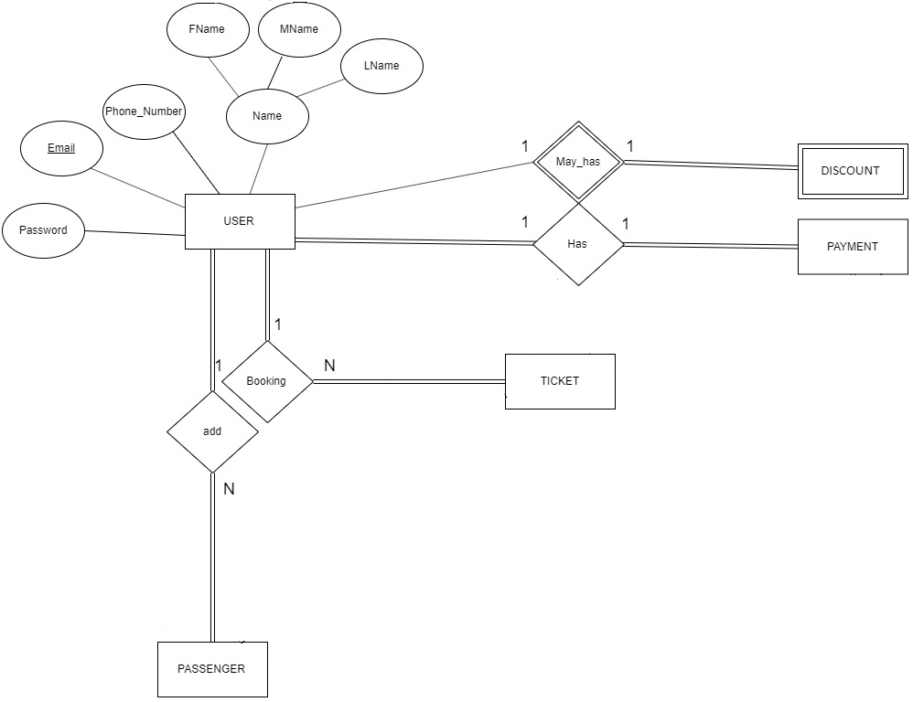
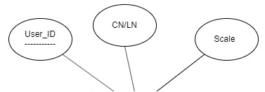
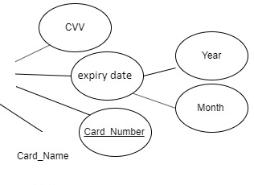
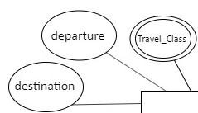
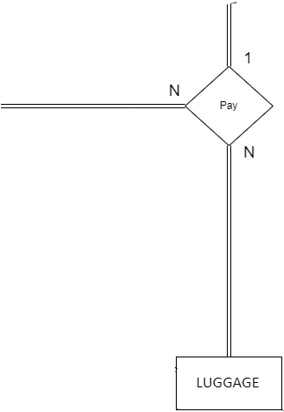
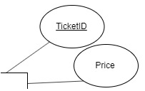
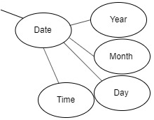
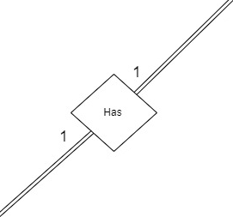
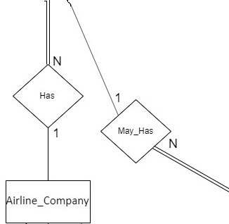

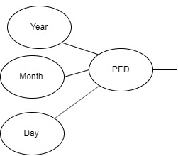
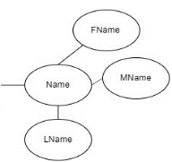
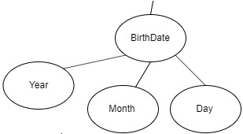
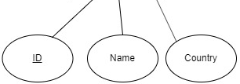
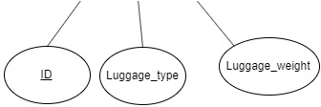
3-ER Model Diagram
The USER has a name (FName , MName,LName), phone number, password, and Email. Email is unique for each user.The user has PAYMENT , adds the PASSENGERs to the trip, may has DISCOUNT, and booking TICKET.
Entity: USER,PASSENGER, TICKET.
Attribute: name , phone_number, password.
Primary Key : Email.
Relation : has, add, may_has.
The LUGGAGE has ID, luggage type, luggage weight. ID has unique values for each bag. The Airline company has Name , ID , country. ID has unique values for each airlines company.
Entity: LUGGAGE, Airline_company
Attribute luggage type, luggage weight, luggage ID, Name , Airline Name, Country .
Primary Key : AirlineID, LuggageID.
The passengers has a name (FirstName, MiddleName, LastName), birthdate(Year, Month,Day), PtID/NID,Ped (Passport expiry date) (Year, Month,Day),also has ticket . PtID/NID has unique values for each airlines passenger.
Entity: PASSENGER,.
Attribute: name , birthdate, Ped.
Primary Key : PtID/NID.
Relation : has.
DISCOUNT has User id , CN/LN and Scale .
Entity: DISCOUNT .
Attribute: CN/LN, Scale.
Partial key : User id.
The PAYMENT has a card name, card number, expritydate (Year, Month) , cvv and pays for the tickets and luggage . Card number has unique values for each card.
Entity: PAYMENT
Attribute: card name, expritydate, cvv.
Primary Key : Card number. Relation : pay.
TICKET has a Ticketid ,price, date(year, month, day, time), departure, destination, travel_class (First, business, Economy) .TICKET may has LUGGAGE and has Airline company. Ticketid has unique values for each ticket .
Entity: TICKET.
Attribute: price, date, departure, destination, travel_class .
Primary Key : Ticketid .
Relation : has, may has .

Slide 8
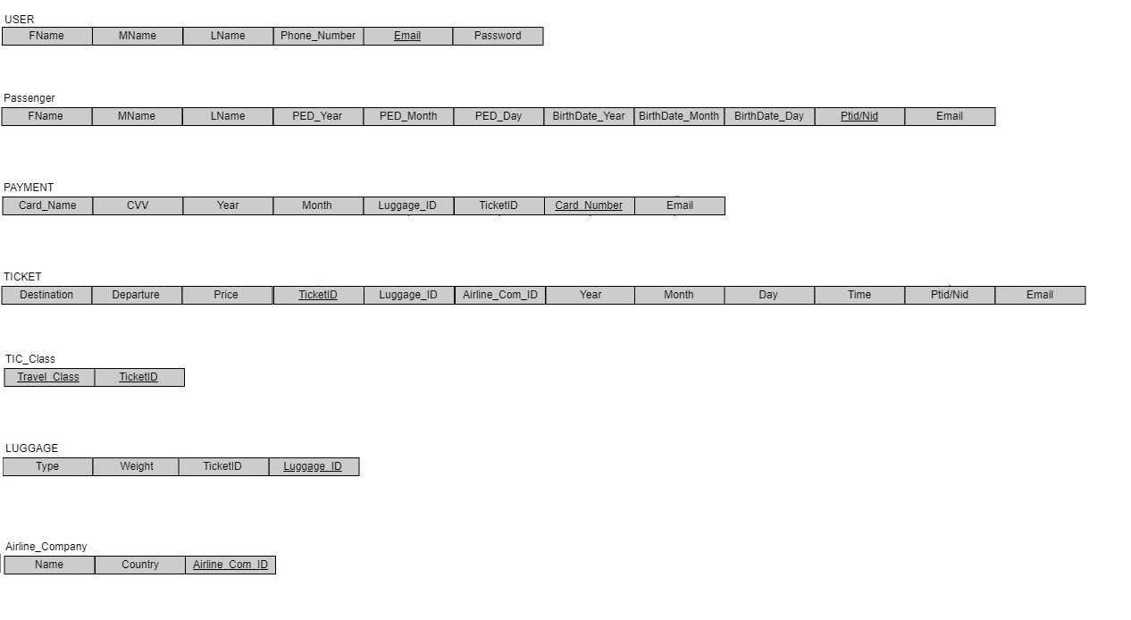

4- Relational Schema
Step 1: Mapping of Regular Entity Types.
Step 2: Mapping of Weak Entity Types
Step 3: Mapping of Binary 1:1 Relation Types
Step 4: Mapping of Binary 1:N Relationship Types.
Step 5: Mapping of Binary M:N Relationship Types.
There is no Relations.
Step 6: Mapping of Multivalued attributes.
Step 7: Mapping of N-ary Relationship Types.

Slide 9
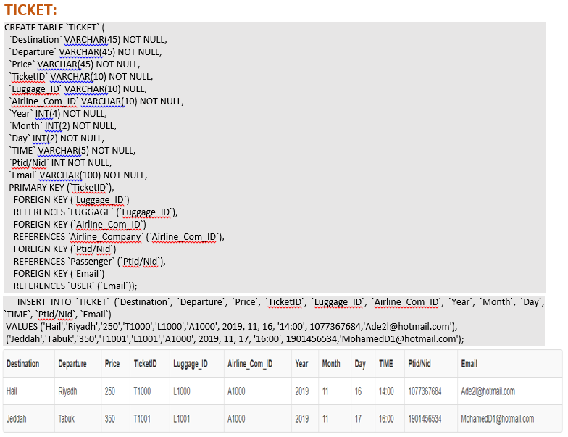
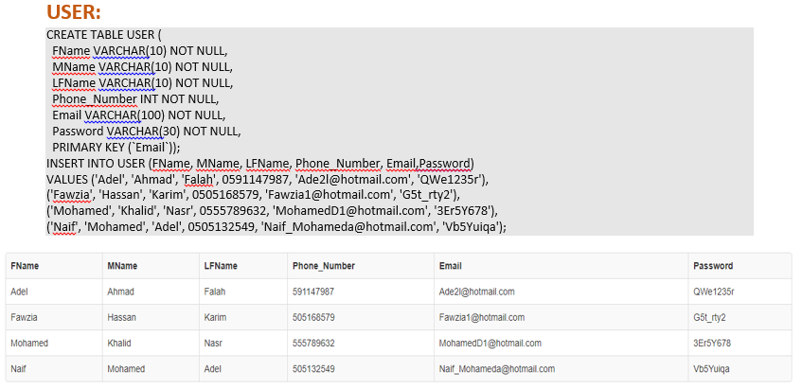
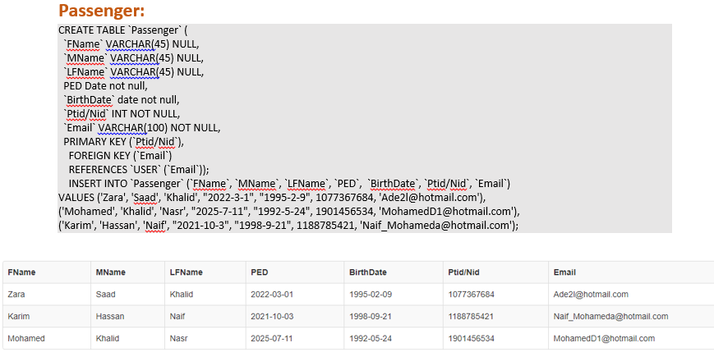
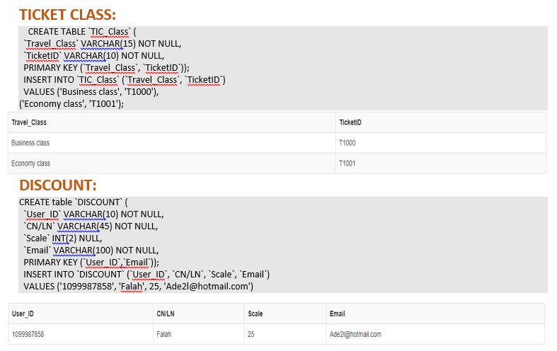
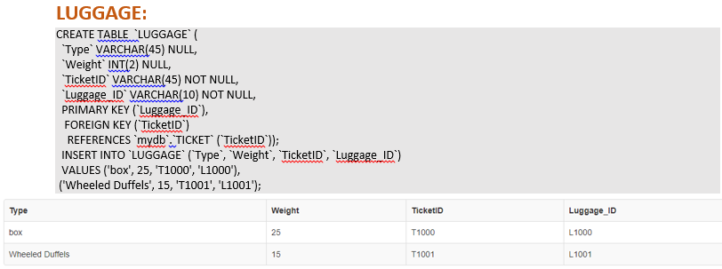
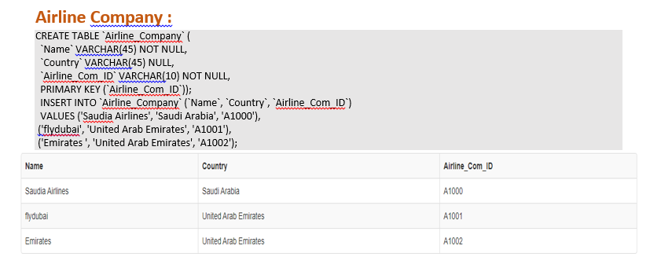
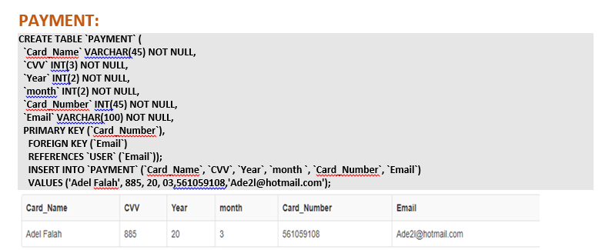
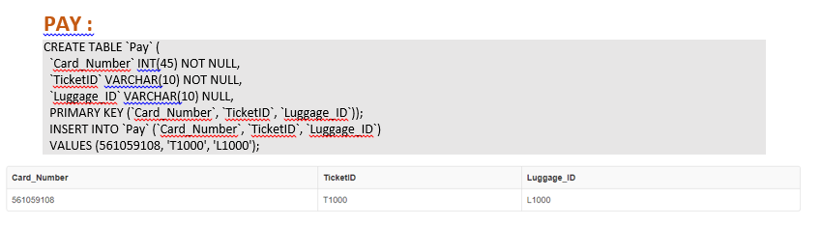
5- Implementation

Slide 10
6- Conclusion
The database design has been completed in the following stages:
Requirements Gathering.
Draw ER model Diagram.
Draw Schema and Relationship.
Implementation.

Slide 11

Question Time

Slide 12
Thank You！
Name: Saleh Ahmad Alheeh
ID:201614721

